Slide 1



Modulo 5
Programación en HTML5 con JavaScript y CSS3

Slide 2
Objetivo Terminal del Modulo 5 (1/2)
Al finalizar este módulo, el participante estará en la capacidad de:
Explica cómo utilizar Visual Studio 2012 para crear y ejecutar una aplicación Web.
Describir las nuevas características de HTML5, y crear estilo HTML5 páginas.
Agregar interactividad a una página de HTML5 con JavaScript.
Crear formularios HTML5 usando diferentes tipos de entrada y validar entradas del usuario mediante atributos HTML5 y código JavaScript.
Enviar y recibir datos de un origen de datos remoto utilizando XMLHTTPRequest objetos y operaciones de AJAX de jQuery.
Páginas de HTML5 estilo utilizando CSS3.
Crear el código JavaScript bien estructurado y fácilmente mantenible.
Utilizar APIs de HTML5 comunes en aplicaciones Web interactivas.
Notes:
20687B
1: Installing and Deploying Windows 8

Slide 3
Objetivo Terminal del Modulo 5 (2/2)
Crear aplicaciones Web que soportan las operaciones fuera de línea.
Crear páginas Web HTML5 que pueden adaptarse a diferentes dispositivos y factores de forma.
Añadir gráficos avanzados para una página HTML5 utilizando elementos de tela y usando y gráficos vectoriales escalables.
Mejorar la experiencia de usuario añadiendo animaciones en una página HTML5.
Usar Web Sockets para enviar y recibir datos entre una aplicación Web y un servidor.
Mejorar la capacidad de respuesta de una aplicación Web que realiza operaciones de larga duración mediante el uso de procesos de trabajo de la Web.
Notes:
20687B
1: Installing and Deploying Windows 8

Slide 4
Contenido de Modulo, por temas
Overview of HTML and CSS
Creating and Styling HTML Pages
Introduction to JavaScript
Creating Forms to Collect and Validate User Input
Communicating with a Remote Server
Styling HTML5 by Using CSS3
Creating Objects and Methods by Using JavaScript
Creating Interactive Pages by Using HTML5 APIs
Notes:
Briefly describe each module and what students will learn. Be careful not to go into too much detail because the course is introduced in detail in Module 1.
Explain how this course will meet students’ expectations by relating the information that is covered in individual modules to their expectations.

Slide 5
Contenido de Modulo, por temas
Adding Offline Support to Web Applications
Implementing an Adaptive User Interface
Creating Advanced Graphics
Animating the User Interface
Implementing Real-time Communication by Using Web Sockets
Performing Background Processing by Using Web Workers
Notes:
Briefly describe each module and what students will learn. Be careful not to go into too much detail because the course is introduced in detail in Module 1.
Explain how this course will meet students’ expectations by relating the information that is covered in individual modules to their expectations.

Slide 6
Creating Advanced Graphics (Creación de gráficos avanzados)

Slide 7
Module Overview
Creating Interactive Graphics by Using SVG Drawing Graphics by Using the Canvas API
Notes:
Graphics is a very broad and encompassing subject, and it would be very easy to spend several hours covering the topics in this area. However, this module is scheduled to last no more than an hour, so remain focused and stick to the basics as they are described by the topics in this module. Refer students who require more information to additional reading.
20480B
11: Creating Advanced Graphics

Slide 8
Lesson 1: Creating Interactive Graphics by Using SVG
What is SVG? Creating SVG Graphics Drawing Circles and Ellipses Drawing Complex Shapes Specifying Fill Styles and Stroke Styles Using Gradients and Patterns Drawing Graphical Text Transforming SVG Elements Demonstration: Using SVG Transformations and Events
Notes:
SVG is very powerful API, but it is also very low level. This lesson concentrates on the core syntax and features of SVG. In the real world, students are likely to use drawing tools and other utilities that can generate the SVG elements as output, and import the resulting content into their websites.
20480B
11: Creating Advanced Graphics

Slide 9
What is SVG?
SVG enables you to draw 2D vector graphics
It defines XML elements to represent a wide range of shapes
SVG uses a "retained mode" model
The objects tree is kept in memory
Rendering speed depends on the number of elements
You can perform the following operations on SVG-related elements:
Access elements through DOM
Style elements with CSS
Handle user-interaction events
Notes:
The key points to mention in this topic are that SVG is scalable and vector-based (hence its name). This enables a developer to define graphics that automatically scale to the user's device, but at the cost of the time and memory required to perform the necessary calculations.
Highlight how the model is fully programmable, enabling a developer to write JavaScript code that can control the way in which an image responds to user input and apply styling.
20480B
11: Creating Advanced Graphics

Slide 10
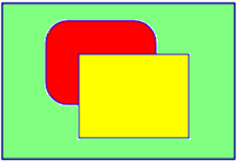
Creating SVG Graphics
Use an <svg> element and embed child elements that define the graphics:
Style SVG elements by using CSS:
<svg xmlns="http://www.w3.org/2000/svg">
<rect x="50" y="50" width="100" height="75"
rx="20" ry="20" fill="red" stroke="blue" />
<rect x="75" y="75" width="100" height="75"
fill="yellow" stroke="blue" />
</svg>
<style type="text/css">
svg {
border: 2px solid darkblue;
background-color: lightgreen;
width: 300px;
height: 200px;
}
</style>
Notes:
Emphasize that SVG graphics consist of a small number of fundamental shapes to which the developer can apply effects and styles.
Note that the file E:\Mod11\Democode\SvgShapes.html contains a copy of many of the SVG examples shown in this lesson. If time allows, open this file by using Notepad and show the code for each example, then display the file in Internet Explorer so that students can see the results.
20480B
11: Creating Advanced Graphics

Slide 11
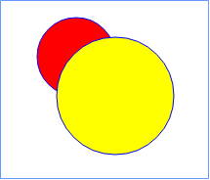
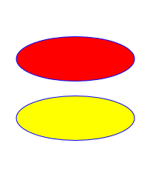
Drawing Circles and Ellipses
To draw circles:
To draw ellipses:
<circle cx="120" cy="80" r="40"
stroke="blue" fill="red" />
<circle cx="160" cy="120" r="60"
stroke="blue" fill="yellow" />
<ellipse cx="150" cy="60" rx="110" ry="30"
stroke="blue" fill="red" />
<ellipse cx="150" cy="140" rx="110" ry="30"
stroke="blue" fill="yellow" />
Notes:
Mention that the order of graphical child elements in the <svg> element determines the Z-order in which they appear; later elements appear in front of earlier elements.
20480B
11: Creating Advanced Graphics

Slide 12
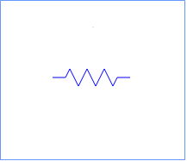
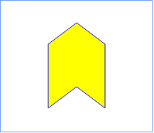
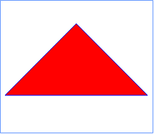
Drawing Complex Shapes
To draw a polyline:
To draw a polygon:
To draw a path:
<polyline points="105 100, 120 100, 125 90, 135 110, 145 90, …
fill="none" stroke="blue" />
<polygon points="110 70, 150 40, 190 70, 190 160, 150 130, 110 160"
fill="yellow" stroke="blue" />
<path d="M 150 50 L 250 150 L 50 150 Z"
fill="red" stroke="blue" />
Notes:
The <path> element is particularly powerful. The commands enable a developer to draw almost any shape or curve. However, do not go into detail, but instead refer students who require more information to the additional reading highlighted in the topic.
20480B
11: Creating Advanced Graphics

Slide 13
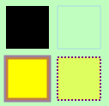
Specifying Fill Styles and Stroke Styles
You can set the fill style or stroke style for an element
stroke="color"
fill="color"
stroke-opacity="opacity-fraction"
fill-opacity="opacity-fraction"
stroke-width="width"
fill-rule="nonzero" | "evenodd"
stroke-dasharray="dash-gap series"
Notes:
Point out that the results of the example code fragments shown in the notes are displayed on the slide.
20480B
11: Creating Advanced Graphics

Slide 14

Using Gradients and Patterns
You can define a linear or radial gradient for shapes
Patterns can specify image files
<polygon points="50,50 250,50 150,200" fill="url(#gradient1)" />
<ellipse cx="150" cy="50" rx="100" ry="20" fill="url(#wales)" />
<circle cx="150" cy="250" r="50" fill="url(#gradient2)" />
Notes:
Do not go into detail on these elements; just point out that they are available and that developers can use them to create an amazing range of effects. However, remind students that complex SVG effects can be processor intensive, so a web page that uses them might incur a performance hit, resulting in slower response times to user actions. Remind students that not all users will necessarily be running a web browser on a -powerful computer that can quickly perform complex arithmetic.
20480B
11: Creating Advanced Graphics

Slide 15

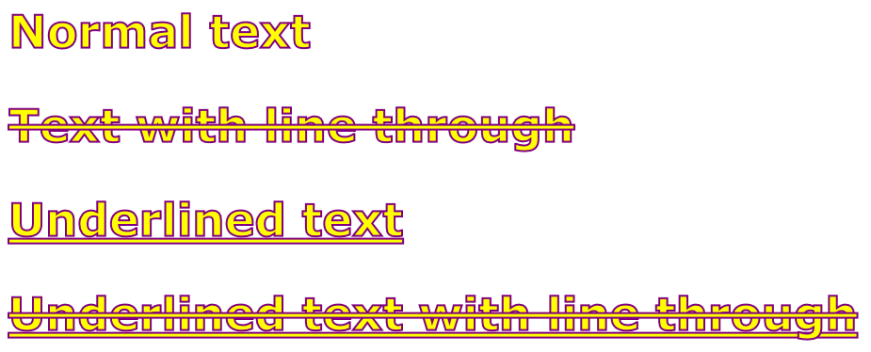
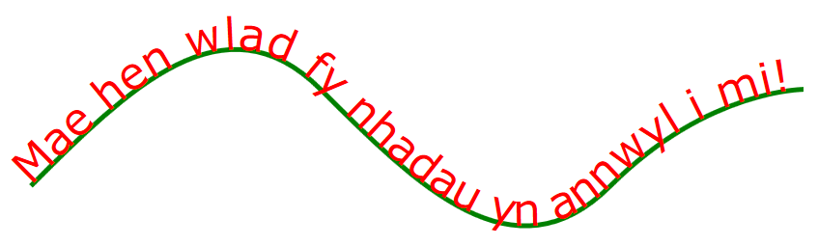
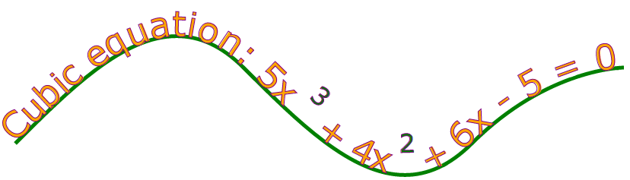
Drawing Graphical Text
<text x="20" y="100">
Simple text
</text>
To draw text:
Use the following elements to achieve additional text effects:
<linearGradient>, <radialGradient>, <pattern>
<textPath>
<tspan>
Notes:
Highlight that drawing basic text is very simple, and that attributes are available to decorate the text.
Again, emphasize that complex styling can result in browser performance degradation.
Mention the use of the <g> element inside an <svg> element to group shapes together.
20480B
11: Creating Advanced Graphics

Slide 16
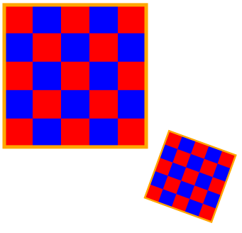
Transforming SVG Elements
To transform SVG elements, set the transform attribute to a transformation function
To perform a transformation on several elements enclose elements in a <g> element, and transform the <g>
rotate(angle, cx, cy)
translate(dx, dy)
scale(sx, sy)
skewX(angle)
skewY(angle)
Notes:
Keep this topic brief. The demonstration that follows provides more detail and examples, and enables students to see how to transform SVG elements.
SVG also describes how to perform animations. However, SVG animations are not supported by Internet Explorer. To animate elements on a web page, use CSS animations; these are described in module 12, "Animating the User Interface".
20480B
11: Creating Advanced Graphics

Slide 17
Demonstration: Using SVG Transformations and Events
In this demonstration, you will see how to:
Transform SVG elements
Handle events on SVG elements
Notes:
The HTML document has two buttons that enable you to demonstrate transformations and events. There is a separate <svg> element for each part of the demonstration. When you click one of the buttons on the page, the page uses the DOM to locate the appropriate <svg> element for that part of the demonstration.
When you click the Transformations button, the web page displays two rectangles. The first rectangle is not transformed. The second rectangle has three transformations applied to it: a translation, a scale, and a skew in the X direction.
When you click the Events button, the web page displays two <path> shapes representing Alaska and Hawaii. The onmousedown event is handled on each shape, to display a message box when the user clicks on the shape. The web page also defines a CSS rule that changes the color of the shape when the user hovers over the shape with the mouse.
Preparation Steps
Start the MSL-TMG1 virtual machine if it is not already running.
Start the 20480B-SEA-DEV11 virtual machine if it is not already running, and log in as Student with the password Pa$$w0rd.
Demonstration Steps
Transform SVG Elements
On the Windows 8 Start screen, click the Desktop tile.
On the Windows taskbar, click Internet Explorer.
In Internet Explorer, open the file E:\Mod11\Democode\SvgDocument.html.
If a message box appears asking if you want to allow blocked content, click the Allow blocked content button.
In Internet Explorer, click the Transformations button.
Right-click the web page in Internet Explorer, and then click View source.
In the source window, locate the <!-- Demonstrate transformations --> comment and review the <svg> element:
The <transform> elements translate the square by 200 units in the X and Y axes, scale it by a factor of 0.5, and rotate it.
20480B
11: Creating Advanced Graphics
(More notes on the next slide)

Slide 18
Text Continuation Slide
Notes:
Close the source window.
Handle Events on SVG Elements
In Internet Explorer, click the Events button.
Hover the mouse over the red shape on the left hand of the window. Verify that the shape changes to a yellow fill color and a dotted green border.
Move the mouse off the shape. Verify that it reverts to a red fill color with no outline.
Hover the mouse over the blue shape on the right side of the window. Verify that the shape changes to a yellow fill color and a dotted green border.
Move the mouse off the shape. Verify that it reverts to a blue fill color with no outline.
Click the red shape. Verify that a message box appears, indicating that the shape represents Alaska. Close the message box.
Click the blue shape. Verify that a message box appears, indicating that the shape represents Hawaii. Close the message box.
Right-click in the browser window, and then click View source.
In the source window, locate the <!-- Demonstrate events --> comment and review the <svg> element:
The <path> elements contain the data that defines the two maps.
Each <path> element responds to the onmousedown event and uses JavaScript code to display the appropriate message.
In the source window, locate the path:hover CSS rule near the top of the document. This CSS rule defines the style for all <path> elements when the user hovers over them with the mouse.
Close the source window.
Close Internet Explorer.
(More notes on the next slide)
20480B
11: Creating Advanced Graphics

Slide 19
Lesson 2: Drawing Graphics by Using the Canvas API
What is the Canvas API? Using the Canvas API Drawing Paths Using Gradients and Patterns Transforming Shapes Demonstration: Performing Transformations by Using the Canvas API Demonstration: Creating Advanced Graphics
Notes:
Mention that the Canvas API is a programmatic interface, compared to the more declarative style of SVG.
20480B
11: Creating Advanced Graphics

Slide 20
What is the Canvas API?
The Canvas API enables you to draw onto a bitmap area
Immediate mode: "fire and forget"
It does not remember what you drew last
JavaScript APIs and drawing primitives
Simple API: 45 methods, 21 attributes
Rectangles, lines, fills, arcs, Bezier curves, …
No DOM support
A canvas is a "black box"
Notes:
Emphasize that Canvas is a programmatic API and that other than the <canvas> element, the DOM has no knowledge of the items that comprise the graphics on a canvas.
20480B
11: Creating Advanced Graphics

Slide 21
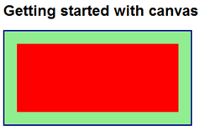
Using the Canvas API
Create a <canvas> element
Define styles for the <canvas> element
Write JavaScript code to draw on the canvas
<h1>Getting started with canvas</h1>
<canvas id="myCanvas">No canvas support</canvas>
canvas {
border: 2px solid darkblue;
background-color: lightgreen;
}
var canvas = document.getElementById('myCanvas');
var context = canvas.getContext('2d');
context.fillStyle = "red";
context.fillRect(20, 20, canvas.width - 40, canvas.height - 40);
Notes:
The basic API is very simple: get a reference to a <canvas> element, and then get a drawing context. Use the drawing context to draw and fill shapes and lines on the canvas.
Emphasize that CSS styling only applies to the <canvas> element itself; you cannot use CSS to style the elements drawn on a canvas.
20480B
11: Creating Advanced Graphics

Slide 22
Drawing Paths
Use a path to draw a complex shape
Use the beginPath, moveTo, lineTo, and closePath functions to define the shape
Draw the shape by using the stroke function
Specify the style by using the strokeStyle function
Fill the shape by using the fill function
Specify the style by using the fillStyle function
Notes:
As before, these functions are relatively straightforward. If time allows, walk students through the code in the notes so that the students can see how to use each function in context.
20480B
11: Creating Advanced Graphics

Slide 23

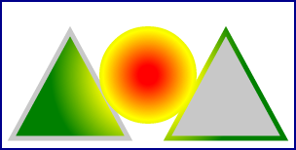

Using Gradients and Patterns
To fill a shape with a gradient:
To fill a shape with a pattern:
var grad = ctx.createLinearGradient(x1, y1, x2, y2);
var grad = ctx.createRadialGradient(startCx, startYy, startRad,
endCx, endCy, endRad);
grad.addColorStop(fraction1, color1);
grad.addColorStop(fraction2, color2);
…
ctx.fillStyle = grad;
var image = document.getElementById("anImageElement");
var pattern = ctx.createPattern(image, "repeat");
ctx.fillStyle = pattern;
Notes:
The code in the notes provides a more complete example; the code on the slide just shows the highlights.
20480B
11: Creating Advanced Graphics

Slide 24
Transforming Shapes
To rotate the canvas context:
To translate the canvas context:
To scale the canvas context:
To adjust the current transformation matrix:
To set a new transformation matrix:
ctx.rotate(clockwiseAngleInRadians);
ctx.translate(deltaX, deltaY);
ctx.scale(xScaleMultiple, yScaleMultiple);
ctx.transform(scaleX, skewX, scaleY, skewY, translateX, translateY);
ctx.setTransform(scaleX, skewX, scaleY, skewY, translateX, translateY);
Notes:
The demonstration that follows provides an example showing how to use these functions.
20480B
11: Creating Advanced Graphics

Slide 25
Demonstration: Performing Transformations by Using the Canvas API
In this demonstration, you will see how to use the Canvas API to:
Perform simple transformations
Perform matrix transformations
Notes:
When you click the Separate Transformations button, the web page invokes the demoSeparateTransformations() function. This function invokes separate transformation functions on the two-dimensional context. Explain these functions. Also point out the save() and restore() function calls, which save the initial context and then restore it at the end of the drawing operations.
When you click the Matrix Transformations button, the web page invokes the demoMatrixTransformations() function. This function performs a composite relative transformation on the coordinate system, by using the transform() function. The code also contains a commented-out call to setTransform(), to show how to perform an absolute transformation. Explain the difference between transform() and setTransform().
Preparation Steps
Start the MSL-TMG1 virtual machine if it is not already running.
Start the 20480B-SEA-DEV11 virtual machine if it is not already running, and log in as Student with the password Pa$$w0rd.
Demonstration Steps
Perform Simple Transformations
On the Windows 8 Start screen, click the Desktop tile.
On the Windows taskbar, click Internet Explorer.
In Internet Explorer, open the file E:\Mod11\Democode\CanvasDocument.html.
If a message box appears asking if you want to allow blocked content, click the Allow blocked content button.
In Internet Explorer, click the Separate Transformations button.
Right-click the web page in Internet Explorer, and then click View source.
In the source window, locate the demoSeperateTransformations function and review the code:
The demoSeperateTransformations function uses the drawShape function to draw a
20480B
11: Creating Advanced Graphics
(More notes on the next slide)

Slide 26
Text Continuation Slide
Notes:
triangle filled with an image of the Welsh flag.
Before calling the drawShape function, the code transforms the context; it moves the canvas to the right and down by half the width and height of the canvas, then it scales the context by a different value in the X and Y dimensions, and then rotates the context by PI/4 radians.
When the drawShape function is called, the image is transformed according to the context settings.
Note: If time allows, comment out each of the transformations and run the code again. Then uncomment each transformation one at a time, so that students can see the effects of each one.
Perform Matrix Transformation
In Internet Explorer, click the Matrix Transformations button.
In the source window, locate the demoMatrixTransformations function and review the code:
This function is similar to the previous one in that it transforms the context and then calls the drawShape function to display the image.
The difference is that this function uses the transform function to perform a matrix transformation, scaling, skewing, and translating the context in a single function call.
Close the source window.
Close Internet Explorer.
(More notes on the next slide)
20480B
11: Creating Advanced Graphics

Slide 27
Demonstration: Creating Advanced Graphics
In this demonstration, you will learn about the tasks that you will perform in the lab for this module.
Notes:
Read the Lab Scenario to students and point out that they should read each scenario before attempting the lab for a module.
Point out to students that the Exercise Scenario for each exercise contains a description of what they will accomplish in the exercise, and is also essential reading.
Start Visual Studio, and open the ContosoConf.sln solution in the E:\Mod11\Labfiles\Solution\Exercise 2 folder.
On the Debug menu, click Start Without Debugging.
Note: If the message Intranet settings are turned off by default appears, click Don’t show this message again.
In Internet Explorer, on the navigation bar, click Location.
In the message box localhost wants to track your physical location, click Allow once.
Scroll down and point out the location map. Mention that students will implement part of this map in exercise 1.
In the location map, click Room B. Point out that that students will write code to catch the click event of the SVG element that defines the map for room B and use this event to display the sessions being held in that room.
Close Internet Explorer.
In Solution Explorer, expand the ContosoConf project, and then double-click location.htm.
In the Code Editor window, find the <svg viewBox …> element, and explain that students will implement this element to draw venue map for Room B.
In Solution Explorer, expand the scripts folder, expand the pages folder, and then double-click location-venue.js.
In the Code Editor window, explain that the code in this file handles the click event for the <svg> element and displays the list of sessions that run in the room that the user clicked.
20480B
11: Creating Advanced Graphics
(More notes on the next slide)

Slide 28
Text Continuation Slide
Notes:
In Solution Explorer, double-click speaker-badge.htm.
In the Code Editor window, find the following section:
<section class="page-section badge">
<div class="container">
<h1>Create your speaker badge for ContosoConf</h1>
<!-- TODO: Add canvas here -->
<canvas
width="500"
height="200"
style="border: 1px solid #888"
data-speaker-id="234724"
data-speaker-name="Mark Hanson">
</canvas>
</div>
</section>
Explain that in exercise 2 students will create the <canvas> element in this section and use it to display the photograph of the instructor, rather than using an <img> element.
Preparation Steps
Start the MSL-TMG1 virtual machine if it is not already running.
Start the 20480B-SEA-DEV11 virtual machine if it is not already running, and log on as Student with the password Pa$$w0rd.
(More notes on the next slide)
20480B
11: Creating Advanced Graphics

Slide 29
Lab: Creating Advanced Graphics
Exercise 1: Creating an Interactive Venue Map by Using SVG Exercise 2: Creating a Speaker Badge by Using the Canvas API
Logon Information
Virtual Machines: 20480B-SEA-DEV11, MSL-TMG1
User Name: Student
Password: Pa$$w0rd
Estimated Time: 60 minutes
Notes:
Exercise 1: Creating an Interactive Venue Map by Using SVG
In this exercise, you will create an interactive conference venue map.
First, you will complete the partially completed SVG mark-up of the venue map. Next, you will add interactive styling to the SVG by using CSS. Then you will handle SVG element click events to display extra information about conference rooms. Finally, you will run the application, view the Location page, and verify that the venue map is interactive.
Instructor Note: Mention to students that a working solution for this exercise is available in the E:\Mod11\Labfiles\Solution\Exercise 1 folder.
Exercise 2: Creating a Speaker Badge by Using the Canvas API
In this exercise, you will use the Canvas API to draw the elements of a conference speaker’s badge.
First, you will create a canvas element on the speaker badge page. Next, you will write JavaScript code to implement methods that draw parts of the badge. Finally, you will run the application and test the speaker badge page.
Instructor Note: Inform students that they should use the ContosoConf project in the E:\Mod11\Labfiles\Starter\Exercise 2 folder.
Mention that a working solution for this exercise is available in the E:\Mod11\Labfiles\Solution\Exercise 2 folder.
20480B
11: Creating Advanced Graphics

Slide 30
Lab Scenario
The conference organizers would like a venue map displayed on the website. Conference attendees will use the map to find out more about the rooms of the conference facility. Therefore, the map should be interactive, responding to mouse clicks. The floor plans are available in a vector format, so they can be displayed in a resolution-independent format.
Conference speakers need badges with their photo, name, and ID. The ID is in the form of a barcode to make it easy for security personnel to scan and verify the holder’s identity before allowing backstage access. You have been asked to create a web page that enables a speaker to create a badge.
Notes:
20480B
11: Creating Advanced Graphics

Slide 31
Module Review and Takeaways
Review Question(s)
Notes:
Review Question(s)
Question
Which of the following statements about SVG is false?
( )Option 1: You can use SVG to draw complex shapes, and fill them with gradients and patterns.
( )Option 2: SVG elements are parsed by the browser when the page is first loaded, and they are then discarded from memory.
( )Option 3: You can create SVG elements dynamically by using DOM functions such as document.createElement().
( )Option 4: You can handle events on SVG elements.
( )Option 5: SVG elements must be enclosed in an <svg> container element on a web page.
Answer
(√) Option 2: SVG elements are parsed by the browser when the page is first loaded, and they are then discarded from memory.
Question
When might you consider using the Canvas API instead of using SVG?
20480B
11: Creating Advanced Graphics

